Slide 1
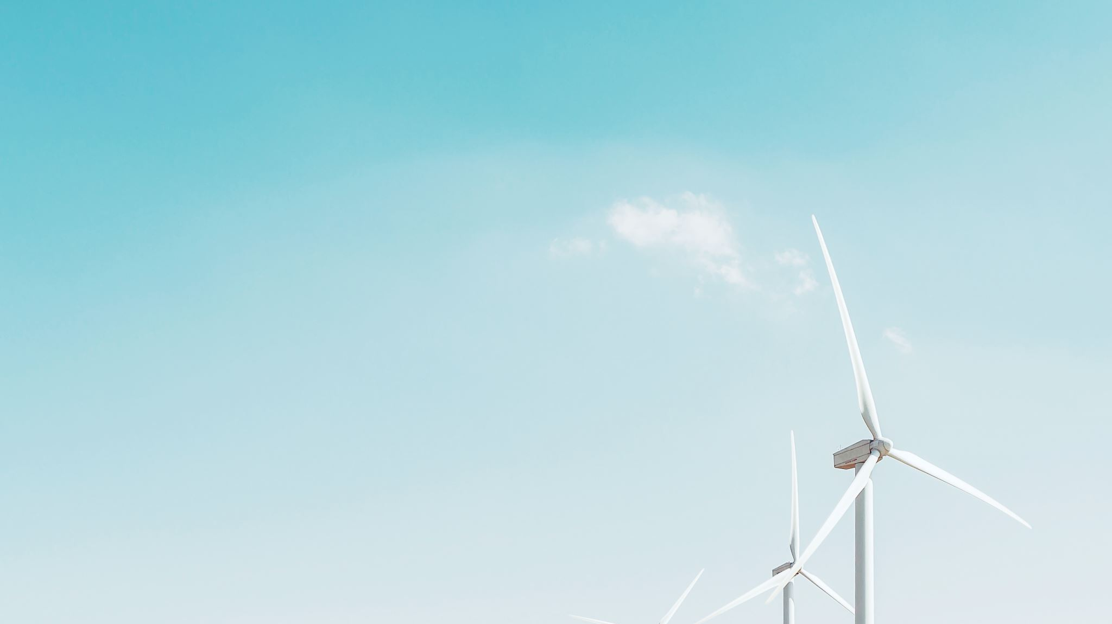
NextEra Energy Financial Decision Making
Prachi Wilson Jacob

Slide 2
Company Overview
Started operating in 1925 as FPL (Florida Power and Light Company)
Officially changed to NEE in 2010 – commitment and expansion
49 states, 4 Canadian provinces
Two principal businesses: FPL – Electric utility in Florida and US
NEER – Renewable energy, long term contracted assets
Provides wholesale power generation
Customers: Retail and municipality electricity providers, industrial corporations, power cooperatives

Slide 3
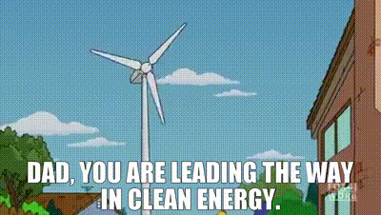
General Facts
World’s largest utility company by market capitalization
12/7/2023 – 122.79 Billion
Generates highest amount of wind and solar energy in the world

Slide 4
NEE vs. Southern Co.
NEE reported revenue increase in Q3 2023 by 6.74 compared to industry average of 3.59%
Southern Co.: Gas and electric utility; 9 million customers across 6 states
Southern - 3% increase for 21 years
NextEra – 10% increase for 28 years
PE ratio: NEE (43), SC(22)
SC: Not that disciplined in project completion
Southern: Focus on regulated business; nuclear power plant efforts
NEE: Regulated powering its non-regulated business
SC: Safe to invest, NEE: Safe and strong stocks
NextEra is a leader

Slide 5
Strengths
Diversified portfolio with renewable energy focus
Weaknesses
Dependance on Renewable Energy
Threats
Competition – pricing wars
Opportunity
Invest in adjacent segments due to free cash flow
Standard and Poor’s: A-
Successful mergers and acquisitions
Good returns on Capital expenditure
Limited international exposure
High debts, increase in interest rates
Eventually expand globally
Drive growth in energy storage solutions
Well-positioned to capitalize on green energy
Energy industry highly regulated – government regulations

Slide 6
Common Sized Balance Sheet - Assets
 | December 31,
 | 2022 | % of Assets | 2021 | % of Assets
Assets
Current assets:
Cash and cash equivalents | $1,601 | 1.01% | $639 | 0.45%
Customer receivables | $4,349 | 2.74% | $3,378 | 2.40%
Other receivables | $744 | 0.47% | $730 | 0.52%
Materials, supplies, and fuel inventory | $1,934 | 1.22% | $1,561 | 1.11%
Regulatory assets | $2,165 | 1.36% | $1,125 | 0.80%
Derivatives | $1,590 | 1.00% | $689 | 0.49%
Other | $1,107 | 0.70% | $1,166 | 0.83%
Total current assets | $13,490 | 8.49% | $9,288 | 6.59%
Other assets:
Property, plant and equipment | $111,059 | 69.88% | $99,348 | 70.50%
Special use funds | $7,496 | 4.72% | $8,922 | 6.33%
Investment in equity method investees | $6,582 | 4.14% | $6,159 | 4.37%
Prepaid benefit costs | $1,832 | 1.15% | $2,243 | 1.59%
Regulatory assets | $5,992 | 3.77% | $4,578 | 3.25%
Derivatives | $1,935 | 1.22% | $1,135 | 0.81%
Goodwill | $4,854 | 3.05% | $4,844 | 3.44%
Other | $5,695 | 3.58% | $4,395 | 3.12%
Total other assets | $145,445 | 91.51% | $131,624 | 93.41%
TOTAL ASSETS | $158,935 | 100.00% | $140,912 | 100.00%

Slide 7
Common Sized Balance Sheet – SE and Liabilities
 | December 31,
 | 2022 | % of Liabilities and Equity | 2021 | % of Liabilities and Equity
Liabilities, Redeemable Noncontrolling Interests and Equity
Current Liabilities:
Commercial paper | $1,709 | 1.08% | $1,382 | 0.98%
Other short-term debt | $1,368 | 0.86% | $700 | 0.50%
Current portion of long-term debt | $6,633 | 4.17% | $1,785 | 1.27%
Accounts payable | $8,312 | 5.23% | $6,935 | 4.92%
Customer deposits | $560 | 0.35% | $485 | 0.34%
Accrued interest and taxes | $719 | 0.45% | $525 | 0.37%
Derivatives | $2,102 | 1.32% | $1,263 | 0.90%
Accrued construction-related expenditures | $1,760 | 1.11% | $1,378 | 0.98%
Regulatory liabilities | $350 | 0.22% | $289 | 0.21%
Other | $3,182 | 2.00% | $2,695 | 1.91%
Total current liabilities | $26,695 | 16.80% | $17,437 | 12.37%
Other liabilities and deferred credits:
Long-term debt | $55,256 | 34.77% | $50,960 | 36.16%
Asset retirement obligations | $3,245 | 2.04% | $3,082 | 2.19%
Deferred income taxes | $9,072 | 5.71% | $8,310 | 5.90%
Regulatory liabilities | $9,626 | 6.06% | $11,273 | 8.00%
Derivatives | $2,909 | 1.83% | $1,713 | 1.22%
Other | $2,696 | 1.70% | $2,468 | 1.75%
Total other liabilities and deferred credits | $82,804 | 52.10% | $77,806 | 55.22%
TOTAL LIABILITIES | $109,499 | 68.90% | $95,243 | 67.59%
Commitments and Contingencies
REDEEMABLE NONCONTROLLING INTERESTS | $1,110 | 0.70% | $245 | 0.17%
Equity
Common stock ($0.01 par value) | $20 | 0.01% | $20 | 0.01%
Additional paid-in capital | $12,720 | 8.00% | $11,271 | 8.00%
Retained earnings | $26,707 | 16.80% | $25,911 | 18.39%
Accumulated other comprehensive loss | ($218) | -0.14% | $0 | 0.00%
Total common shareholders' equity | $39,229 | 24.68% | $37,202 | 26.40%
Noncontrolling interests | $9,097 | 5.72% | $8,222 | 5.83%
TOTAL EQUITY | $48,326 | 30.41% | $45,424 | 32.24%
TOTAL LIABILITIES, REDEEMABLE NONCONTROLLING INTERESTS AND EQUITY | $158,935 | 100.00% | $140,912 | 100.00%

Slide 8
Balance Sheet – Horizontal Analysis
 | December 31,
 | 2022 | 2021 | Amount | Percent
Assets
Current assets | $13,490 | $9,288 | $4,202 | 45.2%
Property, plant and equipment | $111,059 | $99,348 | $11,711 | 11.8%
Other assets | $34,386 | $32,276 | $2,110 | 6.5%
Total assets | $158,935 | $140,912 | $18,023 | 12.8%
Liabilities, Redeemable Noncontrolling Interests and Equity
Current Liabilities | $26,695 | $17,437 | $9,258 | 53.1%
Long-term debt | $55,256 | $50,960 | $4,296 | 8.4%
Other liabilities and deferred credits | $27,548 | $26,846 | $702 | 2.6%
Total liabilities | $109,499 | $95,243 | $14,256 | 15.0%
Redeemable Noncontrolling Interests | $1,110 | $245 | $865 | 353.1%
Equity
Common stock ($0.01 par value) | $20 | $20 | $0 | 0.0%
Additional paid-in capital | $12,720 | $11,271 | $1,449 | 12.9%
Retained earnings | $26,707 | $25,911 | $796 | 3.1%
Accumulated other comprehensive loss | ($218) | $0 | ($218) | -
Total common shareholders' equity | $39,229 | $37,202 | $2,027 | 5.4%
Noncontrolling interests | $9,097 | $8,222 | $875 | 10.6%
Total Equity | $48,326 | $45,424 | $2,902 | 6.4%
Total Liabilities, Redeemable Noncontrolling Interests and Equity | $158,935 | $140,912 | $18,023 | 12.8%

Slide 9
Common Sized Income Statement
 | Years Ended December 31,
 | 2022 | % of Revenues | 2021 | % of Revenues
Operating Revenues | $20,956 | 100.00% | $17,069 | 100.00%
Operating Expenses
Fuel, purchased power and interchange | $6,389 | 30.49% | $4,527 | 26.52%
Other operations and maintenance | $4,428 | 21.13% | $3,981 | 23.32%
Depreciation and amortization | $4,503 | 21.49% | $3,924 | 22.99%
Taxes other than income taxes and other - net | $2,077 | 9.91% | $1,801 | 10.55%
Total operating expenses - net | $17,397 | 83.02% | $14,233 | 83.39%
Gains on Disposal of Businesses/Assets - Net | $522 | 2.49% | $77 | 0.45%
Operating Income | $4,081 | 19.47% | $2,913 | 17.07%
Other Income (Deductions)
Interest Expense | ($585) | -2.79% | ($1,270) | -7.44%
Equity in earnings (losses) of equity method investees | $203 | 0.97% | $666 | 3.90%
Allowance for equity funds used during construction | $112 | 0.53% | $142 | 0.83%
Gains on disposal of investments and other property - net | $80 | 0.38% | $70 | 0.41%
Change in unrealized gains (losses) on equity securities held in NEER’s nuclear decommissioning funds - net | ($461) | -2.20% | $267 | 1.56%
Other net periodic benefit income | $202 | 0.96% | $257 | 1.51%
Other - net | $200 | 0.95% | $130 | 0.76%
Total other income (deductions) - net | ($249) | -1.19% | $262 | 1.53%
Income before Income Taxes | $3,832 | 18.29% | $3,175 | 18.60%
Income Taxes | $586 | 2.80% | $348 | 2.04%
Net Income | $3,246 | 15.49% | $2,827 | 16.56%
Net Loss Attributable to Noncontrolling Interests | $901 | 4.30% | $746 | 4.37%
NET INCOME ATTRIBUTABLE TO NEE | $4,147 | 19.79% | $3,573 | 20.93%

Slide 10
Income Statement – Horizontal Analysis
 | Years Ended December 31,
 | 2022 | 2021 | Amount | Percent
Operating Revenues | $20,956 | $17,069 | $3,887 | 22.8%
Operating Expenses
Fuel, purchased power and interchange | $6,389 | $4,527 | $1,862 | 41.1%
Other operations and maintenance | $4,428 | $3,981 | $447 | 11.2%
Depreciation and amortization | $4,503 | $3,924 | $579 | 14.8%
Taxes other than income taxes and other - net | $2,077 | $1,801 | $276 | 15.3%
Total operating expenses - net | $17,397 | $14,233 | $3,164 | 22.2%
Gains on Disposal of Businesses/Assets - Net | $522 | $77 | $445 | 577.9%
Operating Income | $4,081 | $2,913 | $1,168 | 40.1%
Other Income (Deductions)
Interest Expense | ($585) | ($1,270) | $685 | -53.9%
Equity in earnings (losses) of equity method investees | $203 | $666 | ($463) | -69.5%
Allowance for equity funds used during construction | $112 | $142 | ($30) | -21.1%
Gains on disposal of investments and other property - net | $80 | $70 | $10 | 14.3%
Change in unrealized gains (losses) on equity securities held in NEER's nuclear decommissioning funds - net | ($461) | $267 | ($728) | -272.7%
Other net periodic benefit income | $202 | $257 | ($55) | -21.4%
Other - net | $200 | $130 | $70 | 53.8%
Total other income (deductions) - net | ($249) | $262 | ($511) | -195.0%
Income before Income Taxes | $3,832 | $3,175 | $657 | 20.7%
Income Taxes | $586 | $348 | $238 | 68.4%
Net Income | $3,246 | $2,827 | $419 | 14.8%
Net Loss Attributable to Noncontrolling Interests | $901 | $746 | $155 | 20.8%
NET INCOME ATTRIBUTABLE TO NEE | $4,147 | $3,573 | $574 | 16.1%

Slide 11
Statement of Cashflows
 | Years Ended December 31,
 | 2022 | 2021
Cash Flows from Operating Activities
Net Income | $3,246 | $2,827
Net Cash from Operating activities | $8,262 | $7,553
Net Cash used in investing activities | ($18,359) | ($13,591)
Net Cash provided by financing activities | $12,229 | $5,807
Cash at the end of year | $3,441 | $1,316

Slide 12
Ratio Analysis
Current Ratio = Current Assets/ Current Liabilities
= 0.51
Average Collection Period = 365/Accounts Receivable Turnover = 80.1
Debt to Assets = Total Liabilities/Total Assets
= 68.9%
Times Interest Earned = (Net Income + Interest Expense + Income Tax Expense)/Interest Expense
= 7.55

Slide 13
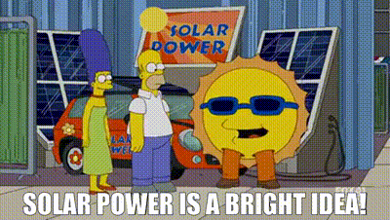
How does the future look?
Build a 310 MW solar power plant in Texas
Operative by 2025
Large plans – generate 730,000 of electricity
Sell natural pipeline assets to fund growth
Achieve real zero carbon emissions by 2025
Double renewable energy to develop 42 GW of energy

Slide 14
Major Risks
Inability to recover costs or return on Assets in a timely manner
Even with the world moving towards green energy, customer growth might be impacted due to competition
NEER’s infrastructure business is exposed to fluctuating oil prices which might affect overall business
Severe and prolonged weather conditions
Greenhouse gas emissions are lower, but new regulations might impact operation. Costs of taxes on emission may not be recoverable.

Slide 15
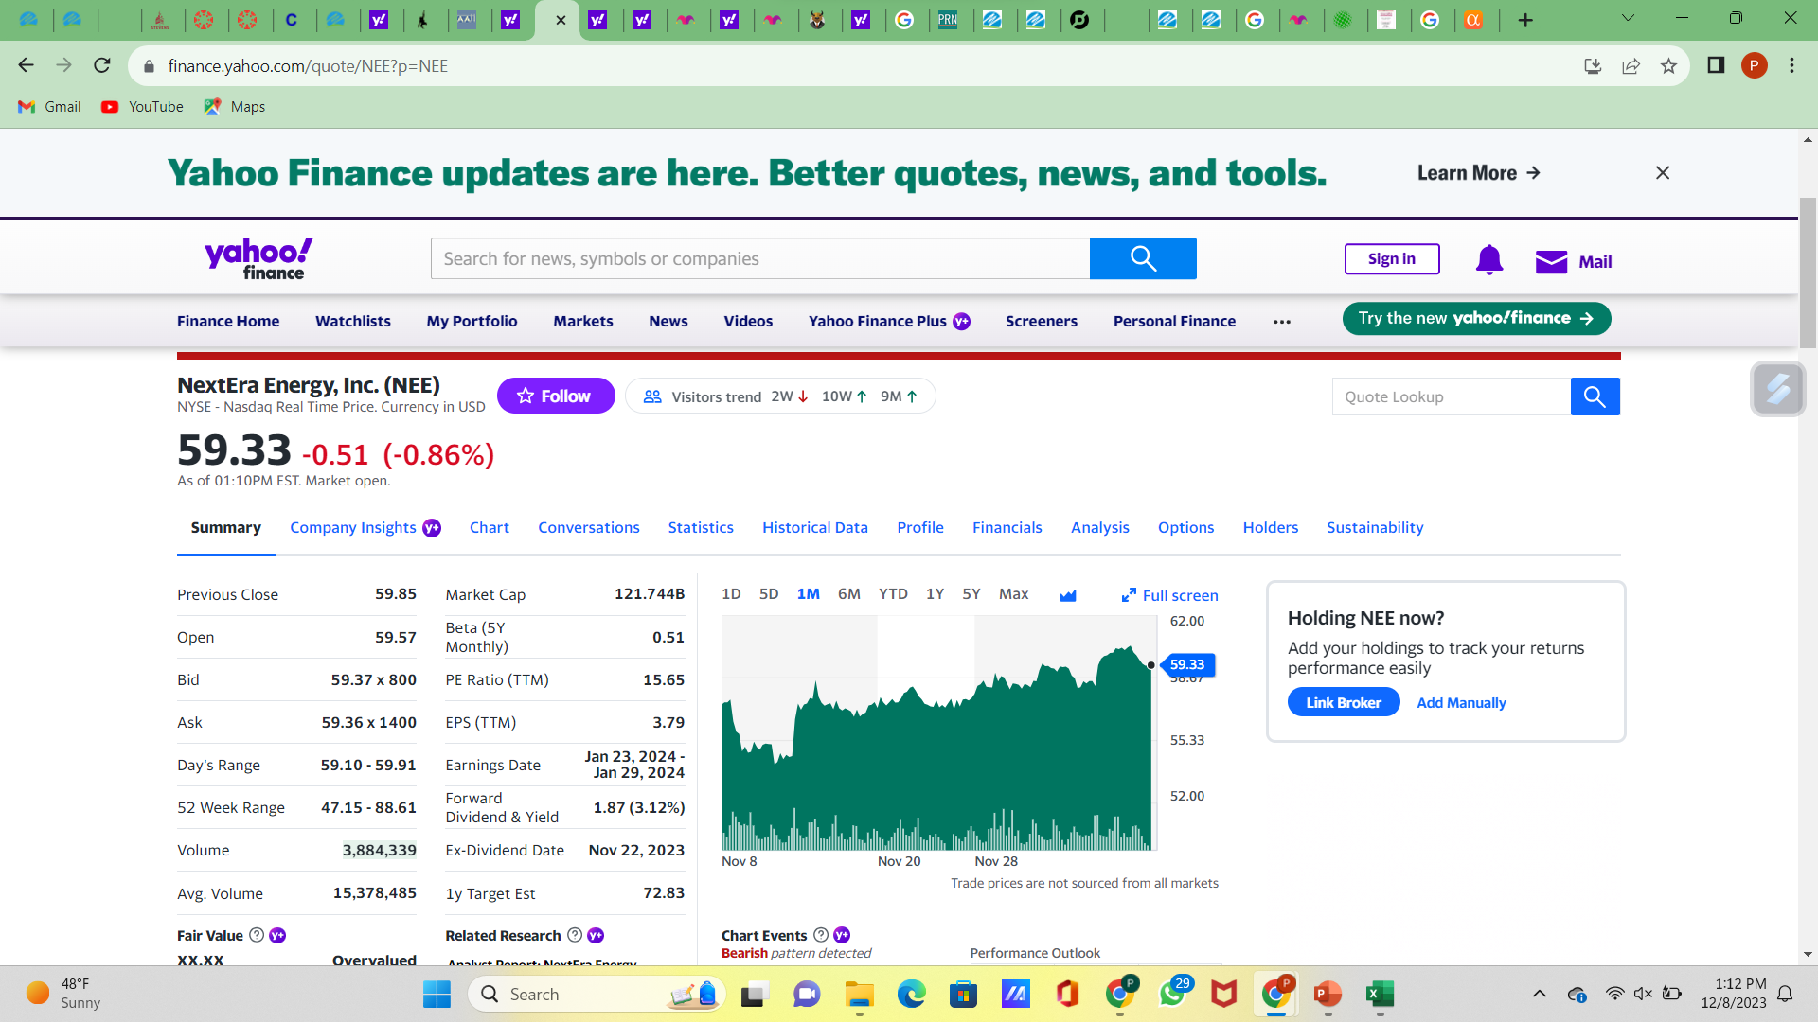
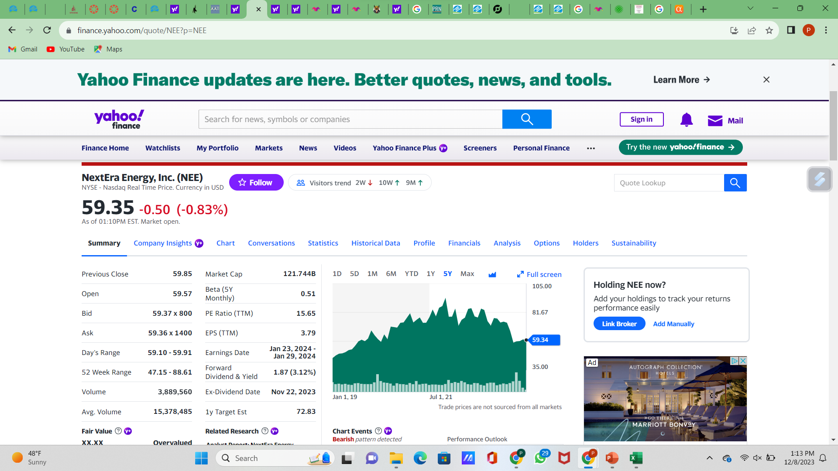
Strategy
Find other means of liquidity apart from selling its business
Keep working towards renewable energy and storage solutions to stay ahead of competition – beneficial when the market eventually blows up
Plans to capture green hydrogen projects should be given importance
Investigate why stockholders are anxious (shares tumbled 13% in November, CEO stepped down) and take effective measures

Slide 16
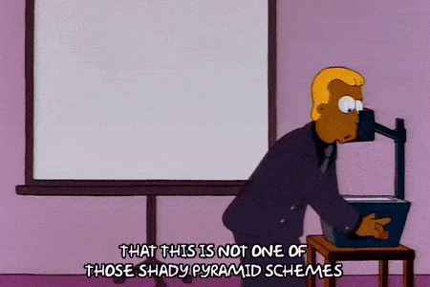

Would you invest??

Slide 17
THANK YOU

Slide 18
References
https://dcf.fm/blogs/blog/nee-swot-analysis
http://fernfortuniversity.com/term-papers/swot/1433/163-nextera-energy.php
https://finance.yahoo.com/quote/NEE?p=NEE
https://www.prnewswire.com/news-releases/nextera-energy-partners-lp-announces-plan-to-become-the-leading-100-renewables-pure-play-investment-opportunity-301818097.html
https://www.utilitydive.com/news/nextera-renewables-expansion-green-hydrogen-solar-alleged-campaign-finance-violation/641475/#:~:text=NextEra%20Energy%20plans%20to%20double,a%20Wednesday%20morning%20earnings%20call.
https://csimarket.com/stocks/compet_glance.php?code=NEE
https://www.investor.nexteraenergy.com/~/media/Files/N/NEE-IR/reports-and-fillings/annual-reports/NEE%202022%20Annual%20Report.pdf
https://www.fool.com/investing/2022/12/23/better-buy-nextera-energy-or-southern-co/

